Slide 1
History of own choices, history of partner’s choices or observed partner’s choice, which can predict current choice better?
Zahra Yousefi Darani
BOS behavioral data analysis
June-August 2023
DPZ

Slide 2
Lets start with a simple model and simple predictors:
Let’s not take into the account if subject observed partner’s choice or predicted partner’s choice (regardless of observation/prediction) and ask:
Previous choices of own has more predictive weight on the current choice (trial n) or previous choices of partner?
So let’s evaluate this model:
Choice on trial n ~ self choice on trial n-1 + self choice on trial n-2 + self choice on trial n-3 + partner’s choice on trial n-1 + partner’s choice on trial n-2 + partner’s choice on trial n-3 + (1|Trial)
I considered random effect for intercept because:
Subject can use any other unknown strategy than the strategy considered in the model on each trial randomly
There is dependency among trials and predictive weight can change randomly trial by trial

Slide 3
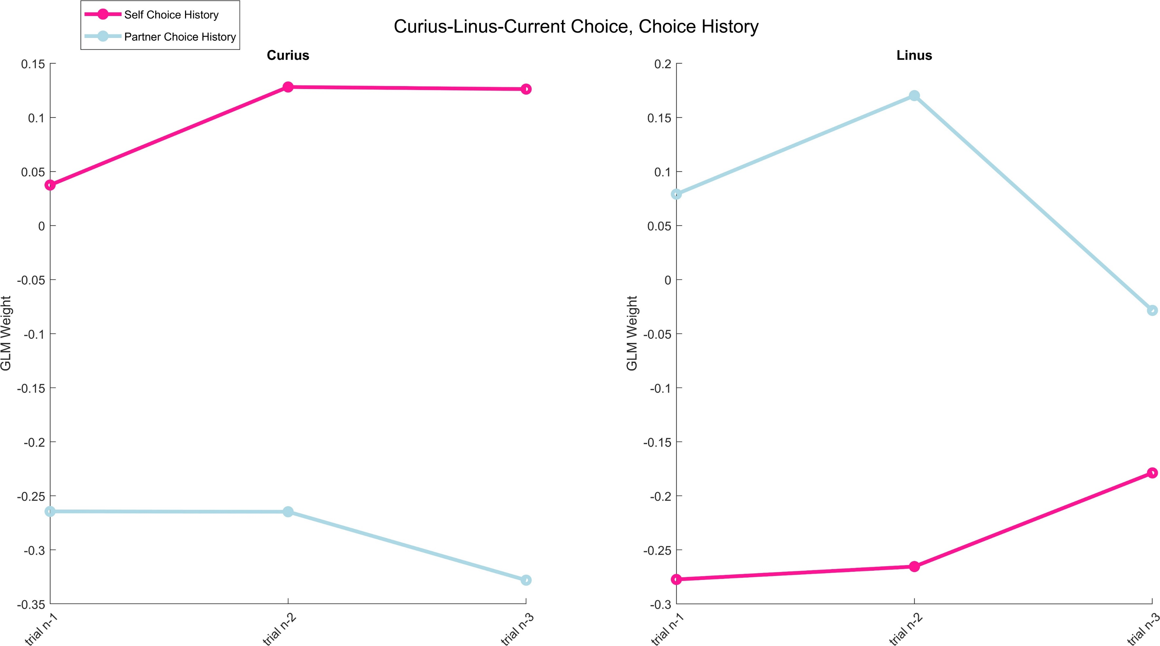
Results

Slide 4
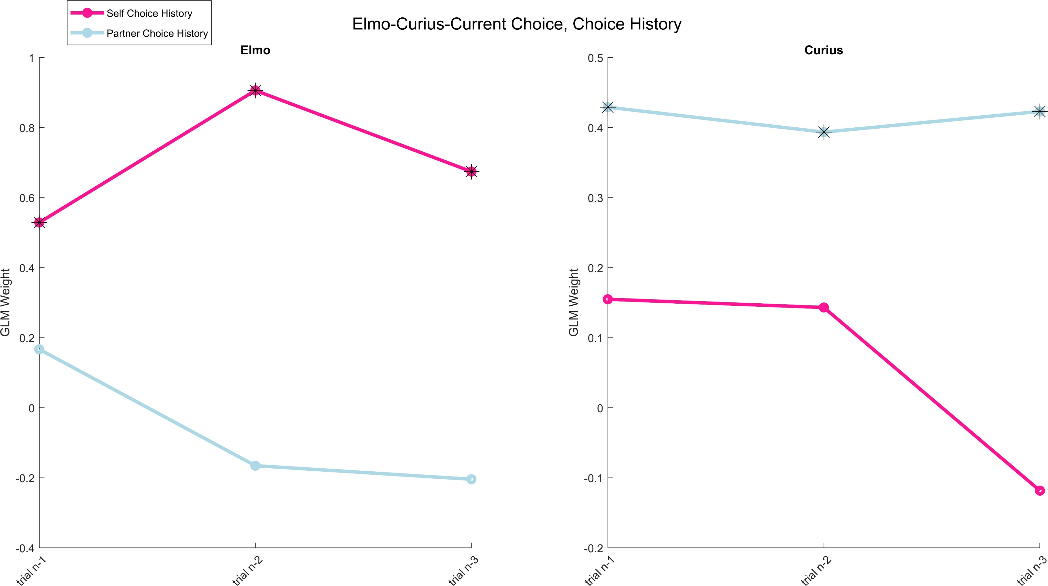
Results

Slide 5
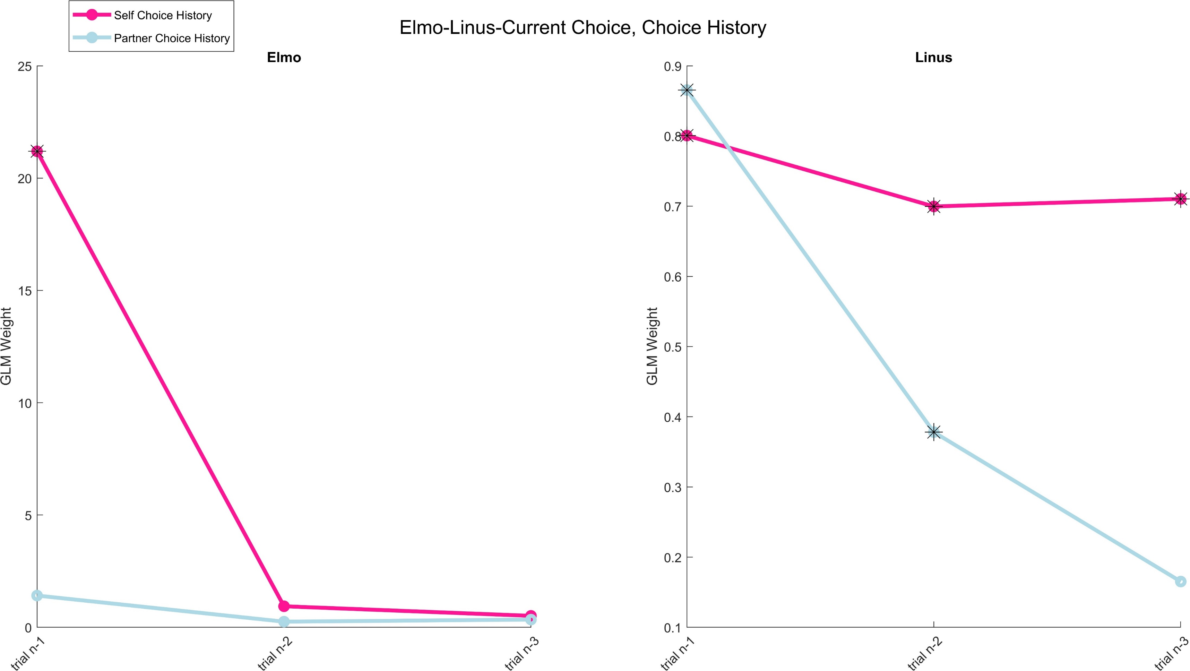
Results

Slide 6
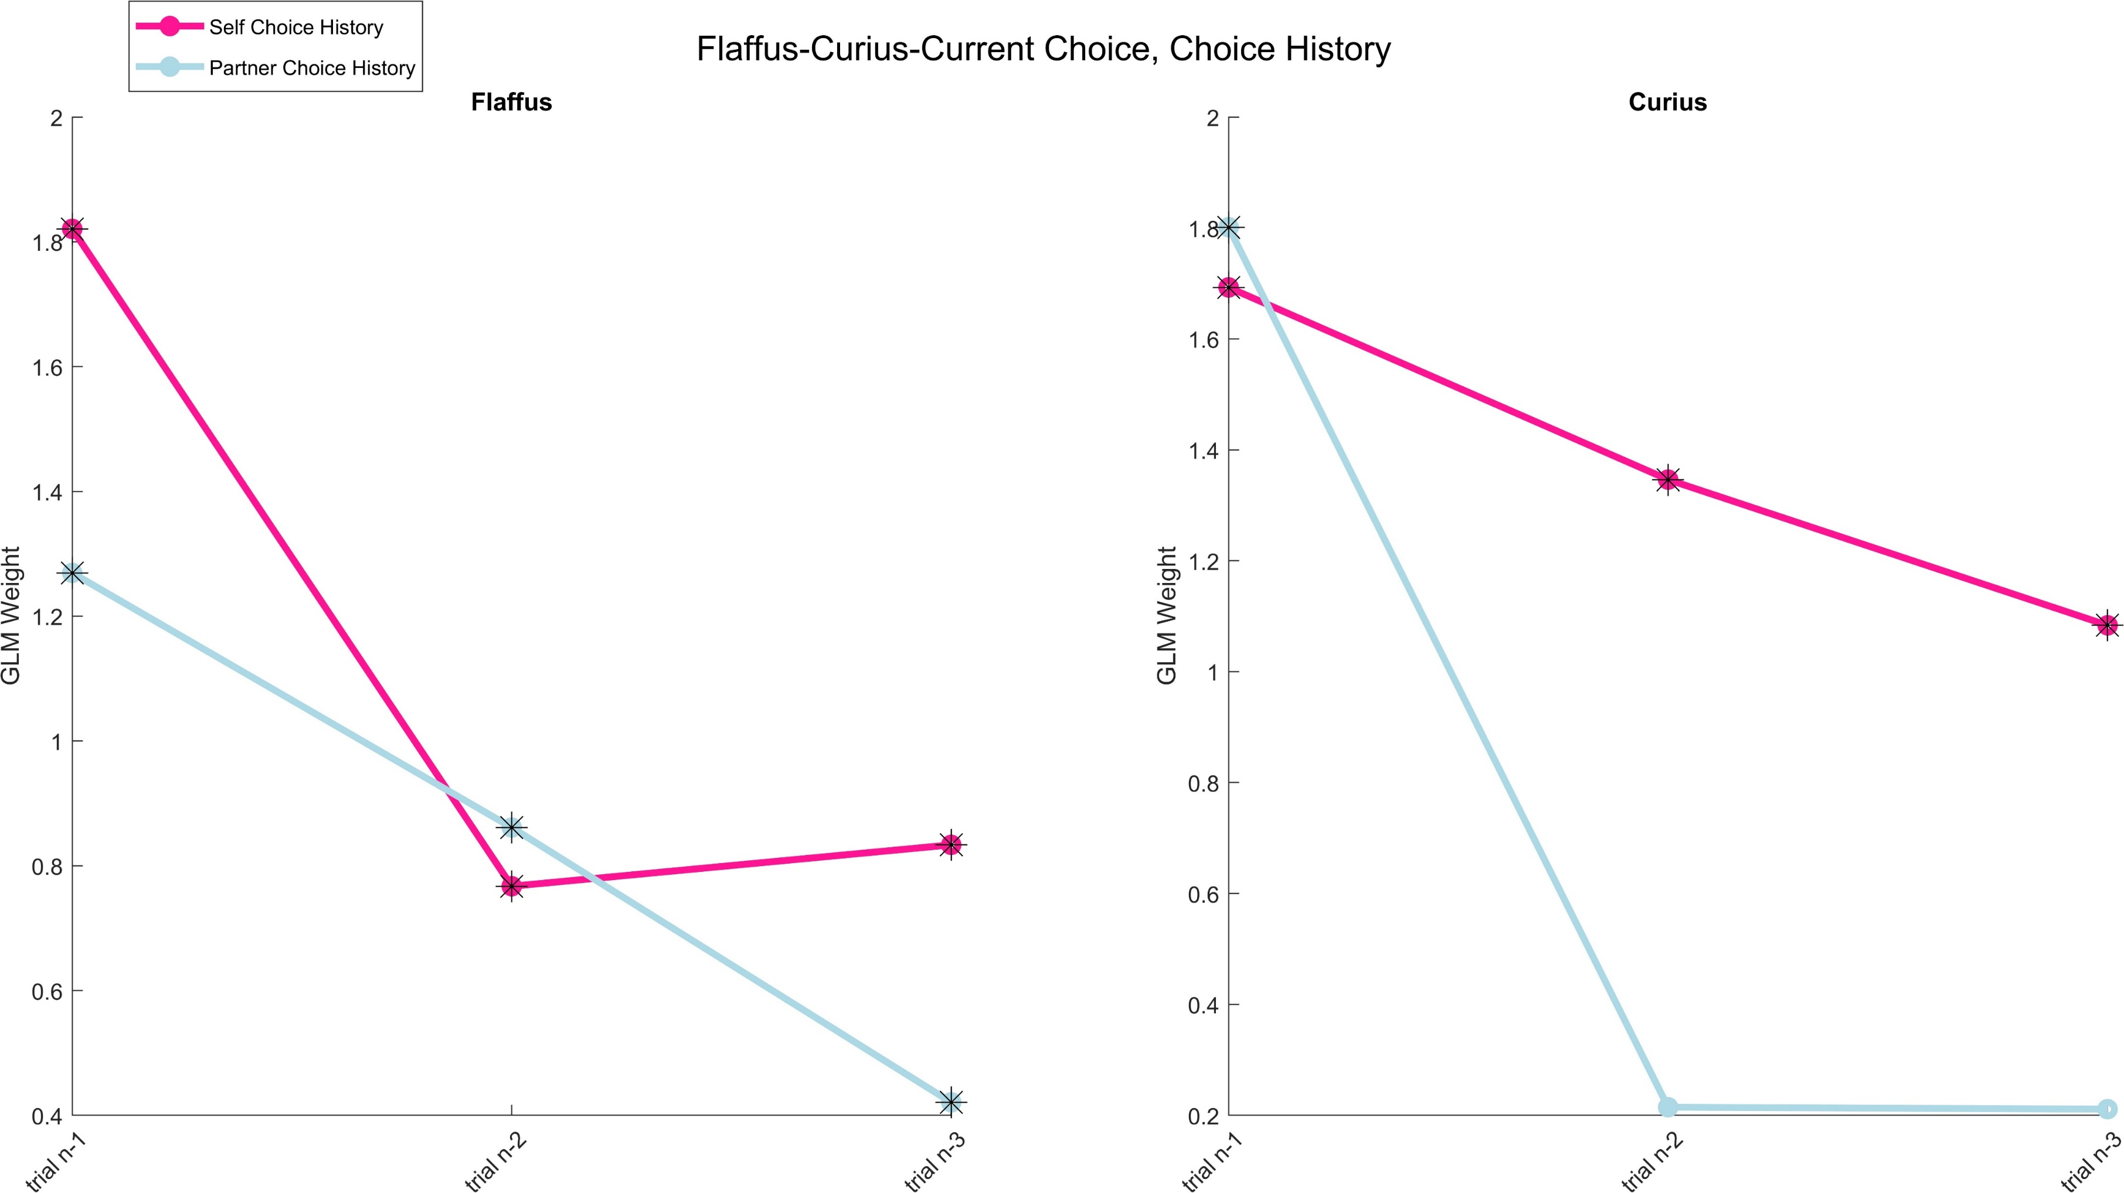
Results

Slide 7
Conclusion
Black stars indicates significant GLMM weight of fixed predictors(p-value < 0.05, p-value belongs to rejection of H0: weights = 0)
Not for all monkeys and not for all past trials, significant GLMM weight change with the same rate.
So I concluded that this model shows us an average effect of ‘’relying on one source of information: history of choice’’ on the current choice. Monkeys may use another source of information: observed choice of partner.
To evaluate this, I divided the choices on trial n into three groups:
when monkey was first
taking action simultaneously with partner
when monkey was second
and then applied this model to these three pools of data.

Slide 8
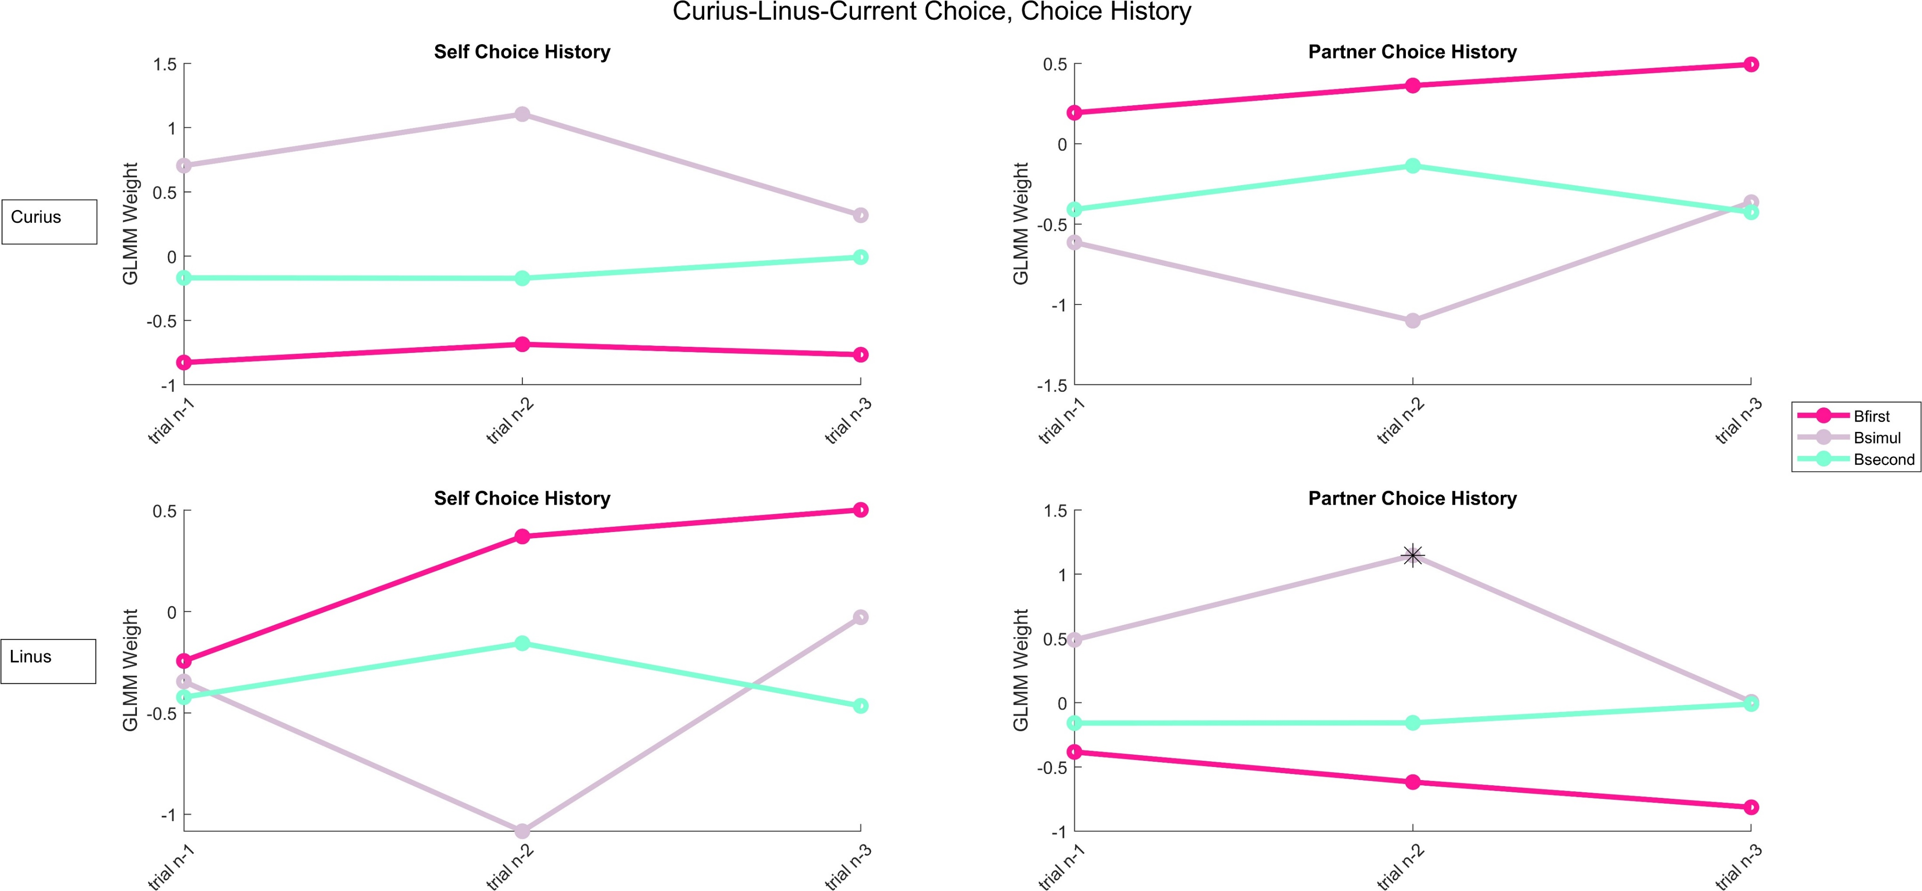
Results

Slide 9
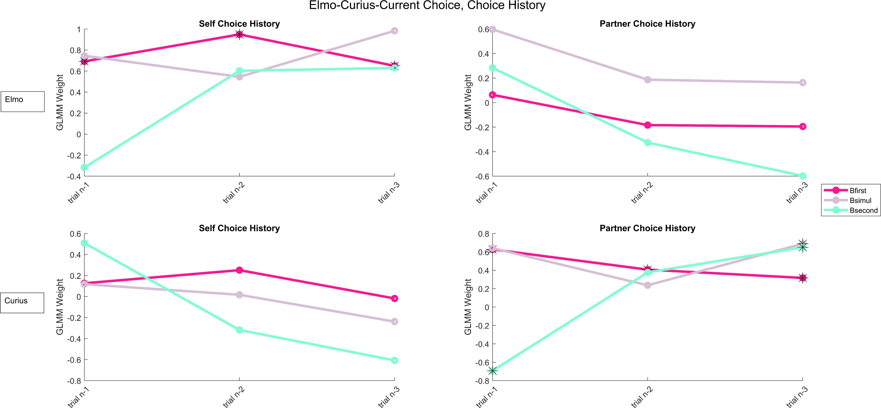
Results

Slide 10
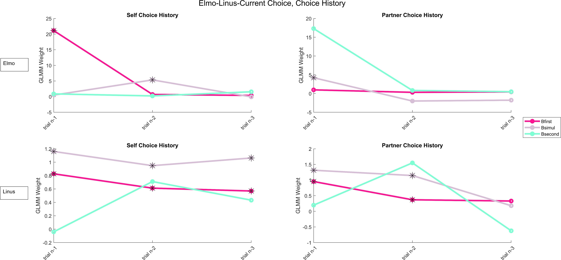
Results

Slide 11
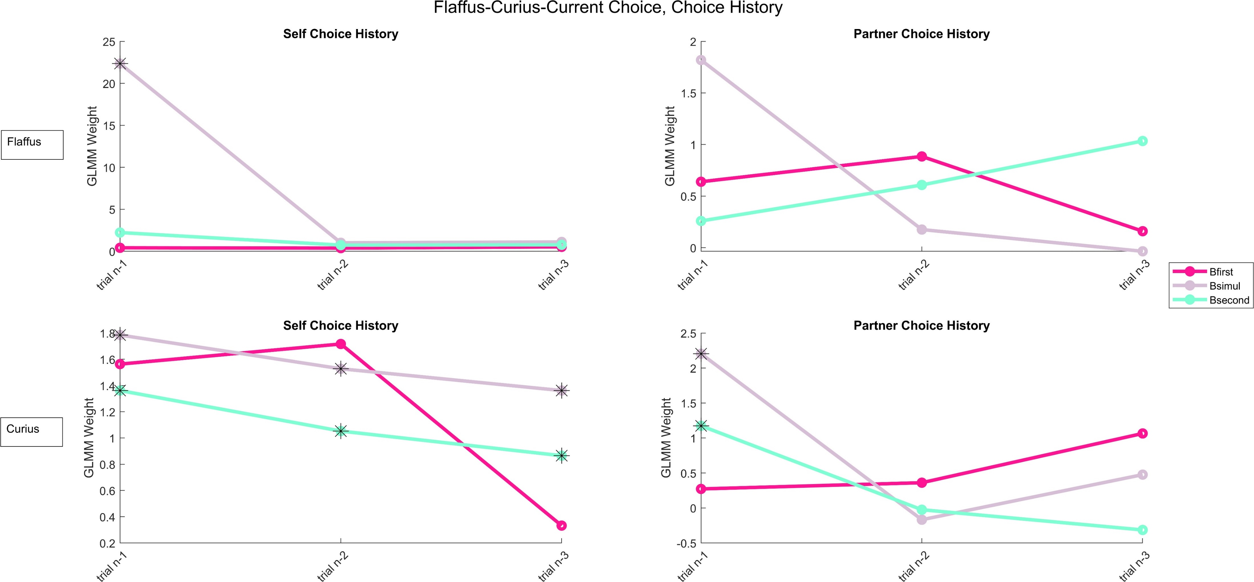
Results
Cur first
Cur second

Slide 12
Conclusion
Not all monkey pairs use the history of choices as a significant source of information for decision-making.(Curius-Linus) not significant at all.
For those monkey pairs there are significant GLMM weight, this significance is well separated by monkey’s turn and own/partner’s choice history
These observations led me to ask:
1) Can one of the predictors (self choice history or partner’s choice history) be sufficient for predicting current choice?
2) How many trials in the past can affect the current choice? (so far we just looked at till n-3)

Slide 13
To answer my questions, I wrote a Granger causality function that…
Evaluates if ‘’self choice time series’’ is enough to predict current choice in an ‘’autoregressive’’ way.
Or ‘’partner’s choice time series’’ significantly can predict current choice better than self choice autoregression.
So H0 evaluates:
Model 1 = Choice on trial n ~ self choice on trial n-1 + self choice on trial n-2 + …+ self choice on trial n-5 + (1|Trial)
H1 evaluates:
Model 2 = Choice on trial n ~ self choice on trial n-1 + self choice on trial n-2 + … +self choice on trial n-5 + partner’s choice on trial n-1 + partner’s choice on trial n-2 + … +partner’s choice on trial n-5 + (1|Trial)

Slide 14
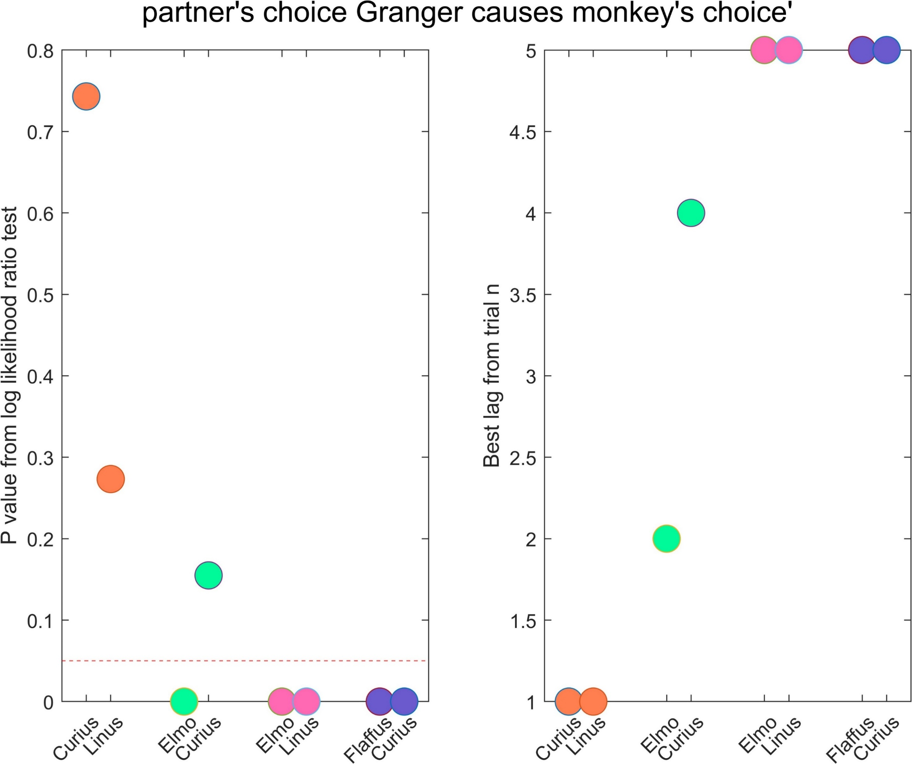
Best lag is extracted by minimizing p-value and maximizing R2

Slide 15
conclusion
P values and best lag of Granger causality showed us that not all individuals use the history of their own choices and the history of their partner’s choices equally.
To evauate how individuals use different sources of information (observation/prediction by using history) with different intensities (different probabilistic weights) I expanded the model to having 3 predictors.
By 1) having three predictors, 2) choosing n-1 lag and 3) considering interaction between history of own choices and partner’s choice
we are able to systematically look at the role of two sources of information in decision making.
Model:
Choice on trial n ~ self choice on trial n-1 * partner’s choice on trial n-1 + observing partner on trial n + (1|Trial)

Slide 16
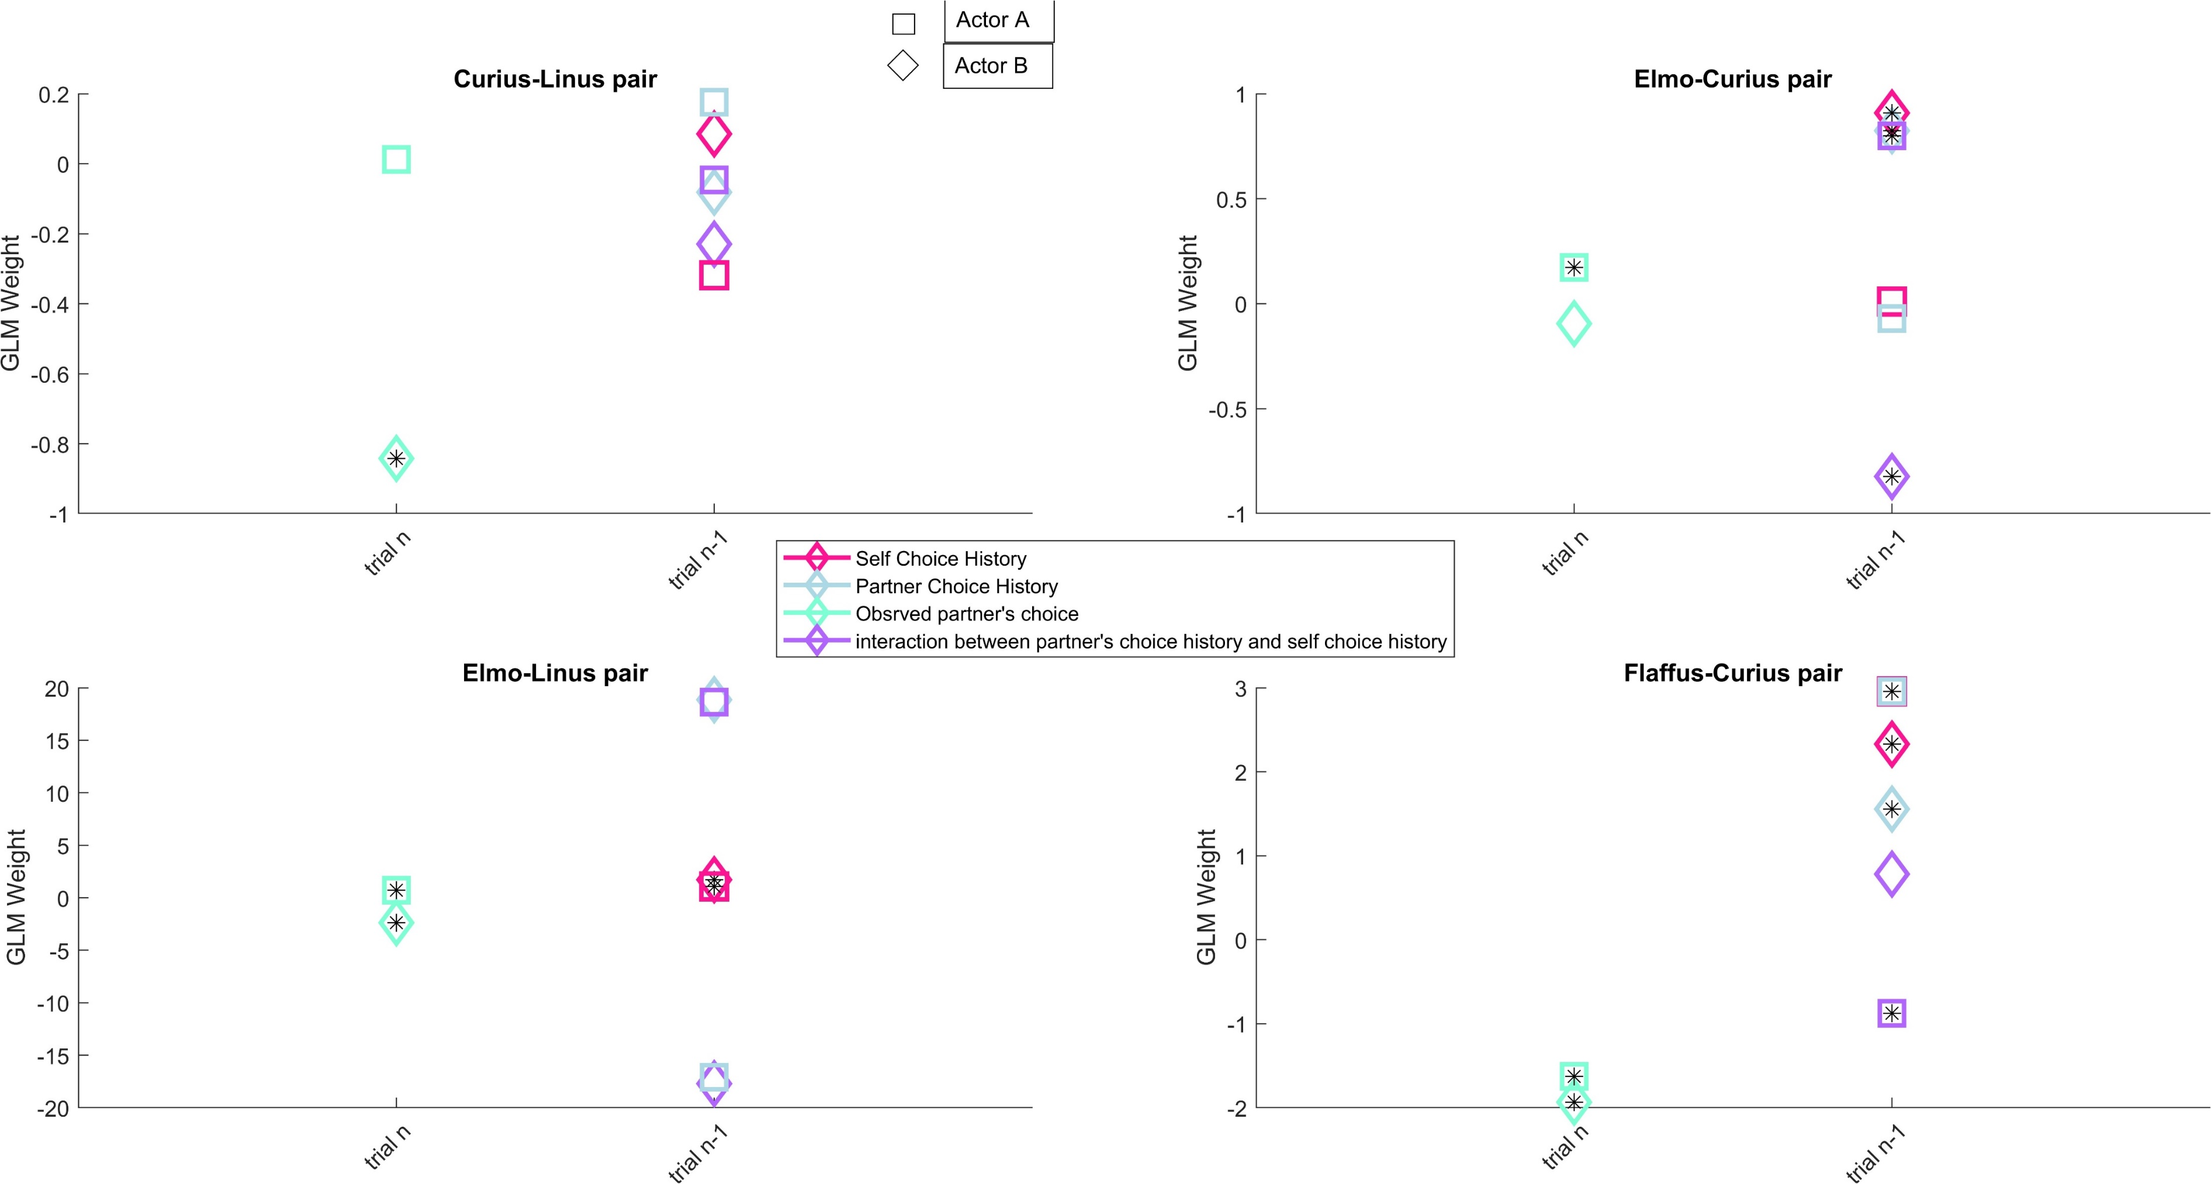
Results

Slide 17
Conclusion and future analsysis
Try spatial choice vector instead of color choice vector on the model (specially for the sessions that are side bias)\
Show ‘’fraction of choosing own’’ and ‘’fraction of choosing left’’ for both real data and model prediction, session by session.

Slide 18
Method
1) As Sebastian used ‘’movemean’’ builtin function of MATLAB with window length = 8 , I used the same to calculate FCO
2) Model predictions are not converted to binary choice (should I convert them?)
3) R2 values reported on top of each plot belong to ‘’point to point’’ data fitting, be aware that they don’t belong to smoothed data
4) for the sessions that model failed due to high collinearity among predictors, for some monkeys you may find empty plots. The reason is that when one predictor is fixed, ‘’corr’’ function of matlab returns to NAN

Slide 19
Results
These are session-to-session analyses, and plots are a lot. PLS look at them in the dropbox

Slide 20
Future analysis
Showing the GLMM weights for each predictor each session: done
Binarized the model output: done
Confdrate training: done
Increase statistical power by concatenating sessions: done

Slide 21
Method
P-value near r reports rejection of H0: r = 0, ask Igor and Sebastian if I have to replace it with t-test p val?

